Slide 1
MODERN PERIOD IN INDIAN HISTORY
TRANSITION OF INDIA
FROM MEDIEVAL TO MODERN PERIOD UNDER
THE RULE OF
EAST INDIA COMPANY

Slide 2
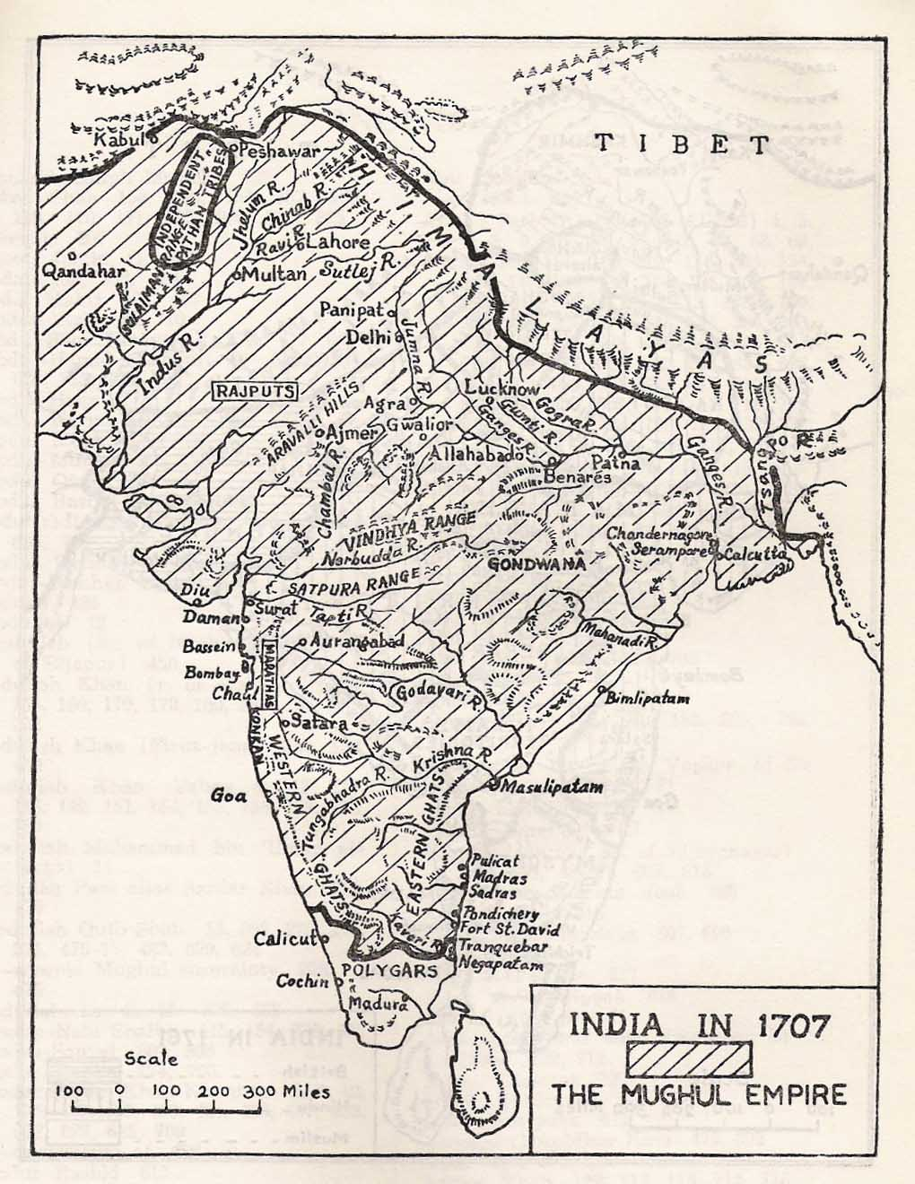
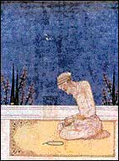
The medieval period saw the disintegration of the Mughal Empire after the death of Aurangzeb.

Slide 3
India in eighteenth century
It was followed by decentralization of power and the emergence of a number of smaller states.

Slide 4
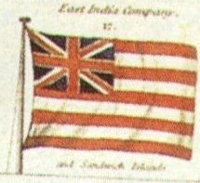
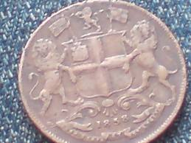
DEVELOPMENTS IN INDIA AND EUROPE
EUROPEANS FROM NATIONS SUCH AS
BRITAIN

Slide 5
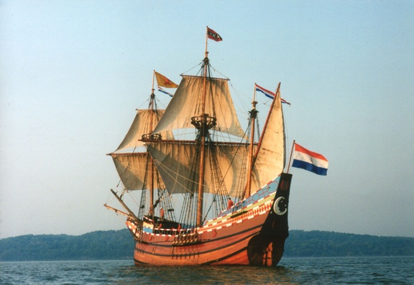
FRANCE

Slide 6
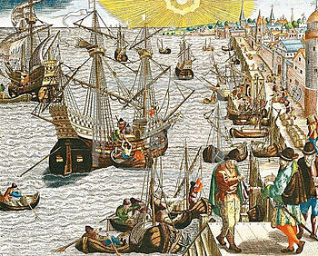
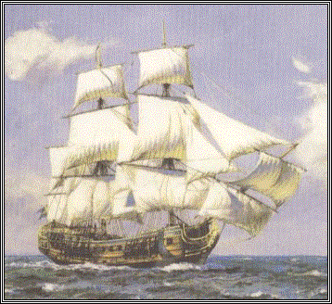
PORTUGAL

Slide 7
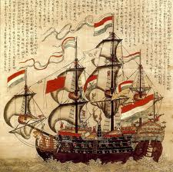
AND NETHERLANDS HAD ENTERED INDIA AS TRADERS AND HAD ESTABLISHED THEIR TRADING POSTS.

Slide 8
INDIA WAS SEEN AS A PRIZE POSSESSION
THE GOLDEN BIRD IN TRICOLOUR

Slide 9
THIS LED TO THE BEGINNING OF ANGO-FRENCH RIVALRY WHICH ENDED WITH THE ESTABLISHMENT OF BRITISH DOMINION.

Slide 10
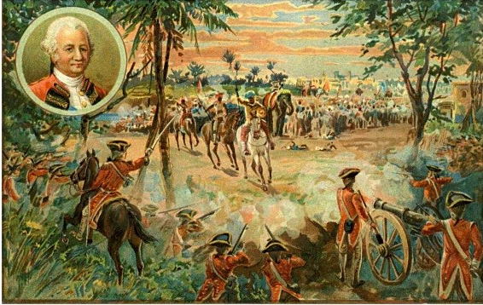
THE BRITISH THEN CONCENTRATED ON THE GRADUAL EXPANSION OF THEIR INDIAN TERRITORY BEGINNING WITH BENGAL IN THE
BATTLE OF PLASSEY

Slide 11
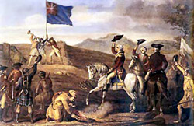
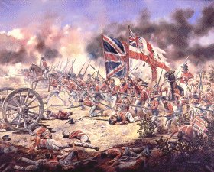
THE BATTLE OF BUXAR IN 1765

Slide 12
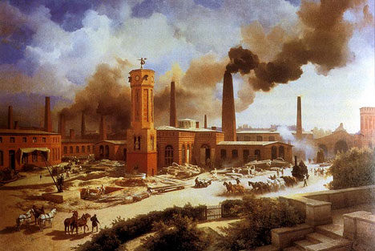
During the eighteenth century, England had gone through the phase of
industrial revolution.

Slide 14
As a result of industrial revolution , capitalism emerged as the basis of economy.
It was basis on the profit making and competition in the market

Slide 15
Effects of capitalism

Slide 16
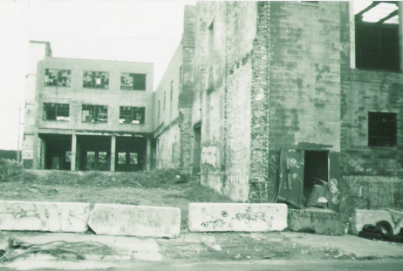
Destruction of Indian traditional industries
There was a destruction of many traditional industries.
This has been termed as ‘deindustrialization’, that is, the reverse of the process of industrialization.

Slide 17
Changes under British rule
British had changed their position from being merely traders to masters of Indian subcontinent.
Expansion of territorial possession of east India company had increased the involvement in tax collection, particularly land revenue.
This often led to the peasant revolt

Slide 18
Changes under British rule
Chapter-3 : changes in administration
Chapter-4 : changes in tax collection
Chapter-5 : change in policies towards tribal societies
Chapter-6 : change in Indian industries
Chapter-7 : unification of Indian subcontinent
Chapter-8 : changes in education
Chapter-9 : change in policies towards women
Chapter-10 : change in policies towards lower castes

Slide 19
Gradually the implications of the British colonial policy became clear and people from all sections felt its effect.
By the mid-nineteenth century, many associations that resisted the British policies at the local level took shape.
In 1885, the first all India association called Indian National Congress was formed.
This led to the beginning National Movement. (chapter-13)

Slide 20
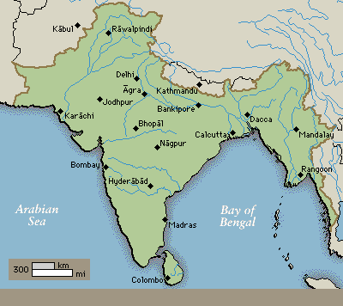
Unification of Indian subcontinent
British conquered the whole of India, from the Himalayas in the north to the Cape Cameron in the south and Assam in the east to the Khyber pass in the west.

Slide 21
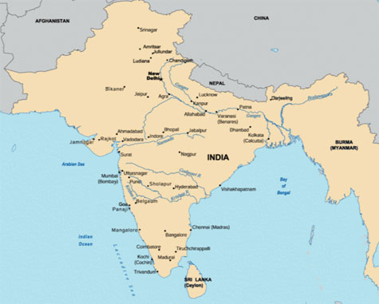
British imposed political unity through their centralized rule and slowly the concept of one nation began to take shape.

Slide 22
Centralized administration,
common economic policies,
common institutions and
common laws led to similar sufferings throughout the nation and fostered the sprit of nationalism.
Thus, the British concept of centralized rule brought political unity in India.

Slide 23
A network of roads and railways unified the country by linking one area to another .

Slide 24
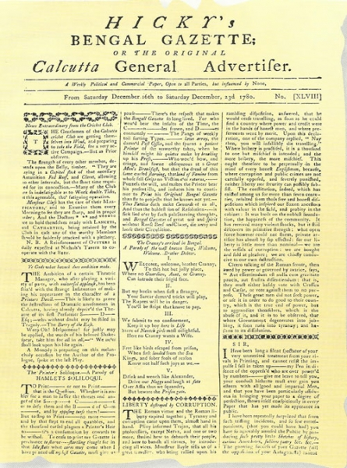
Transmission of news papers brought about a transformation in social, intellectual and political life of people. They could be regular contact with each other.

Slide 25
There was a change in the nomenclature of the subcontinent and it came to be known as
INDIA UNDER BRITISH RULE

Slide 26
PRESENTED BY
PRASHANT SINGH

